Slide 1
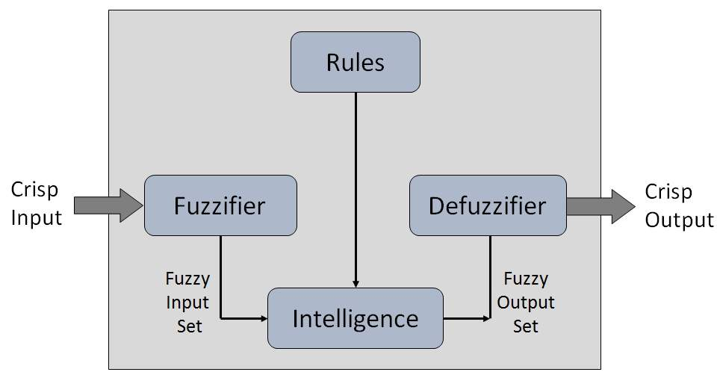
Fuzzy Logic Block Diagram

Slide 2
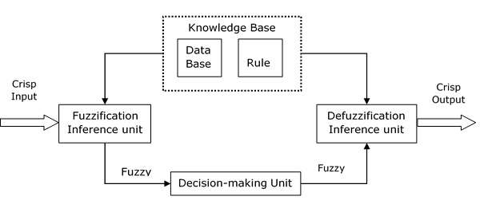

Slide 3
Functional Blocks of FIS
The following five functional blocks will help you understand the construction of FIS −
Rule Base − It contains fuzzy IF-THEN rules.
Database − It defines the membership functions of fuzzy sets used in fuzzy rules.
Decision-making Unit − It performs operation on rules.
Fuzzification Interface Unit − It converts the crisp quantities into fuzzy quantities.
Defuzzification Interface Unit − It converts the fuzzy quantities into crisp quantities. Following is a block diagram of fuzzy interference system.

Slide 4
Fuzzy ruled based system (or) interference Engine
In rule-based fuzzy systems, the relationships between variables are represented by means of fuzzy if–then rules of the following general form:
If antecedent proposition( A set of conditions satisfy ) then consequent proposition( A set of consequent)
The antecedent proposition is always a fuzzy proposition of the type
“~ x is A”
Where
~x is a linguistic variable and
A is a linguistic constant (term).

Slide 5
A collection of rules refering to a particular system is known as fuzzy rule base.
If the conclusion C to be drawn from the rule base R is the conjunction of all the individual Consequents Ci of each rule then
C=C1UC2U......... Cn
µ_{C}(y)= Max (µ_{C1}(y), µ_{C2}(y).......... µ_{Cn}(y))
Similarly for intersection we should consider
µ_{C}(y)= Min (µ_{C1}(y), µ_{C2}(y).......... µ_{Cn}(y))

Slide 6
Graphical Representation of Fuzzy
As a general example, consider the design of a fuzzy controller for a steam turbine.
The block diagram of this control system appears as follows:
The input and output variables map into the following fuzzy set:

Slide 7
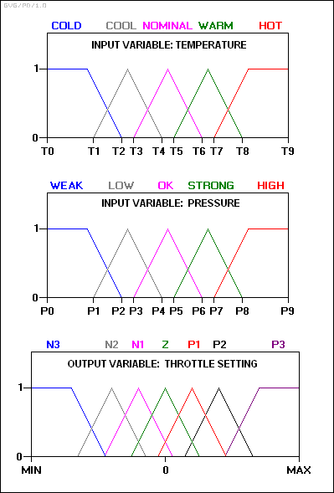

Slide 8
The rule set includes such rules as
rule 1: IF temperature IS cool AND pressure IS weak, THEN throttle is P3.
rule 2: IF temperature IS cool AND pressure IS low, THEN throttle is P2.
rule 3: IF temperature IS cool AND pressure IS ok, THEN throttle is Z.
rule 4: IF temperature IS cool AND pressure IS strong, THEN throttle is N2.

Slide 9
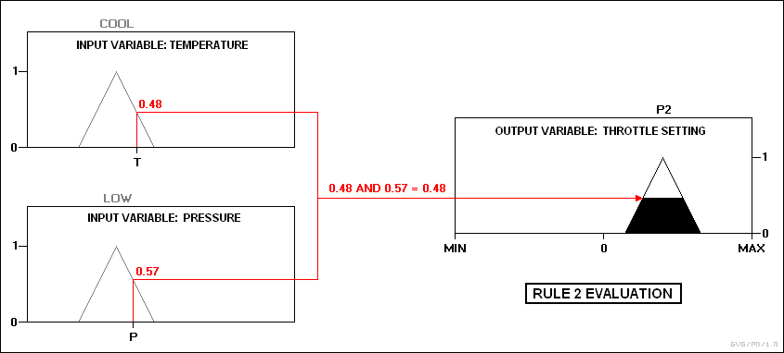
For an example, assume the temperature is in the "cool" state, and the pressure is in the "low" and "ok" states.
The pressure values ensure that only rules 2 and 3 fire:

Slide 10
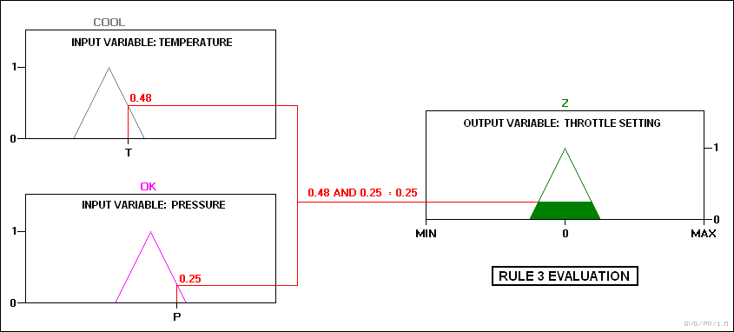

Slide 11
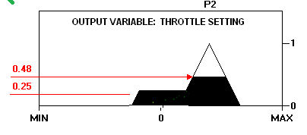

Slide 12
Defuzzification
It is the reverse process of fuzzification.
Defuzzification is the process of producing a quantifiable result in Crisp logic, given fuzzy sets and corresponding membership degrees. It is the process that maps a fuzzy set to a crisp set. It is typically needed in fuzzy control systems.

Slide 13
There are 7 main methods
Max Membership Principle
Weight average Method
Mean Max Method
Centroid Method
Centre of Sum
Centre of largest Area
First Maxima (or) Last Maxima

Slide 14
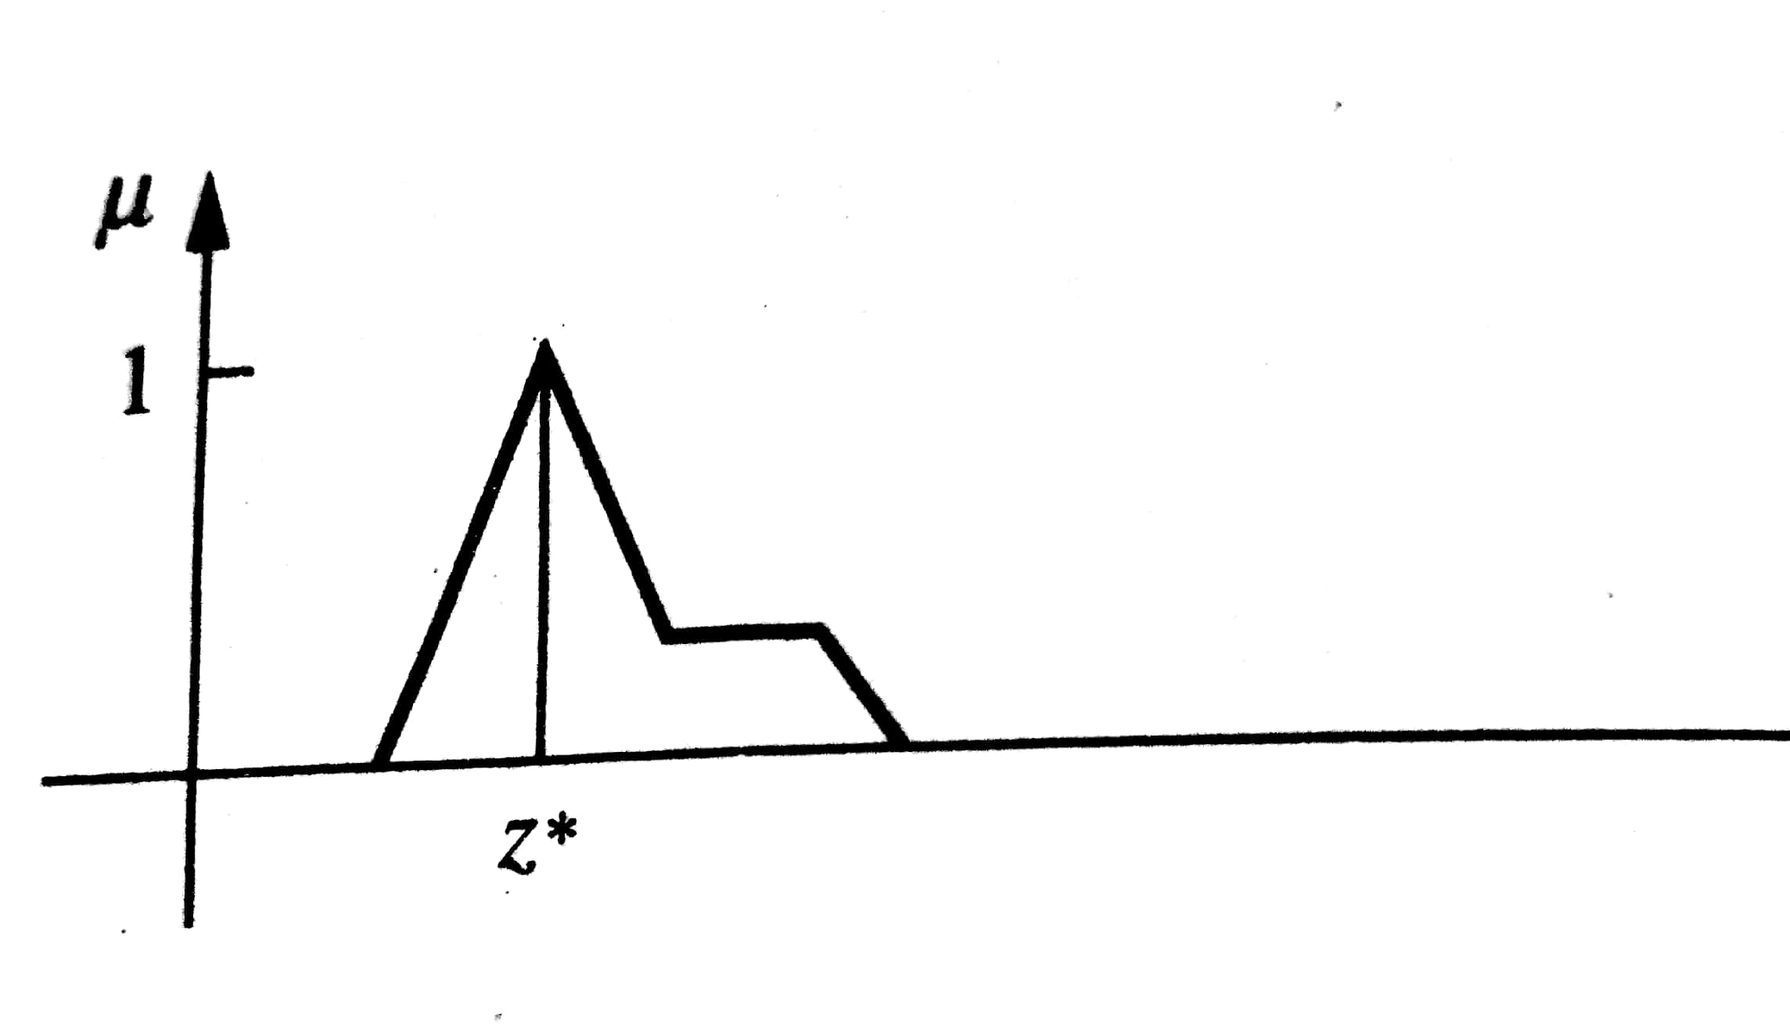
Max Membership Principle

Slide 15
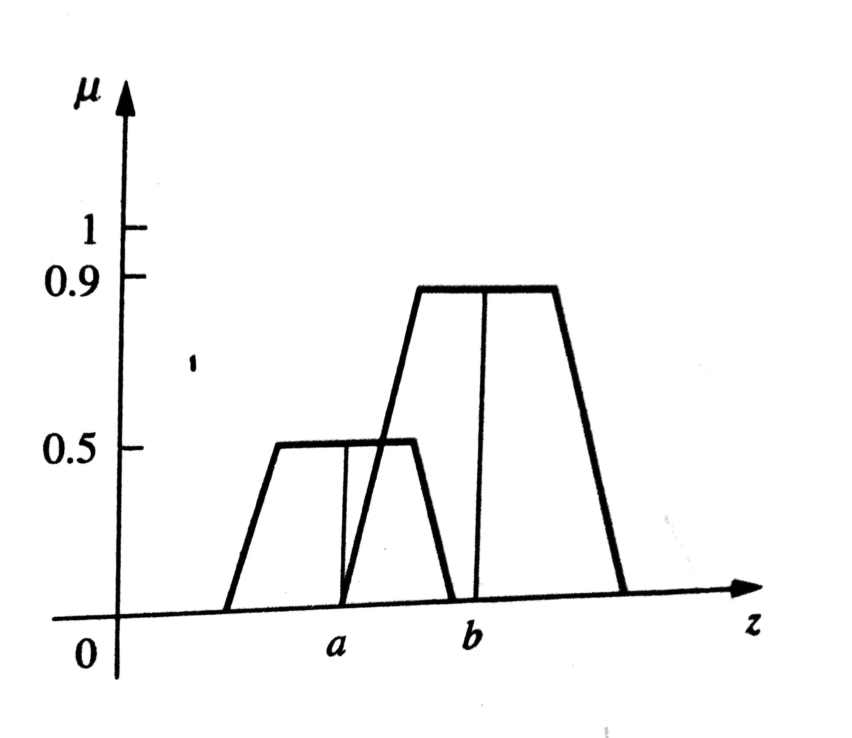
Weight average Method

Slide 16
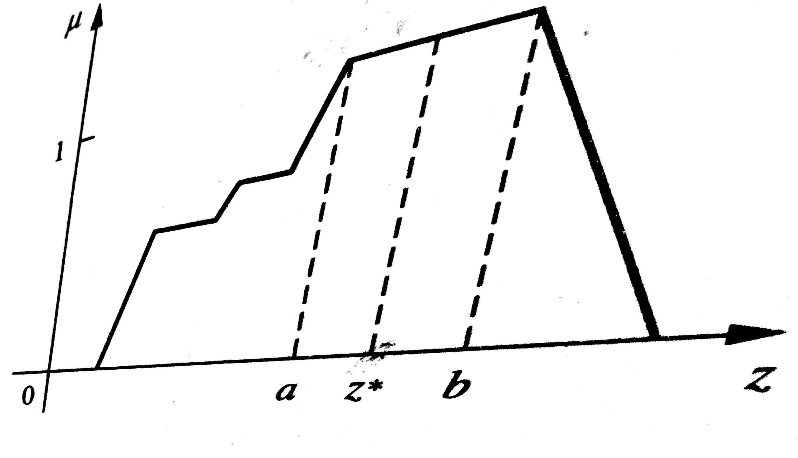
Mean Max Method

Slide 17
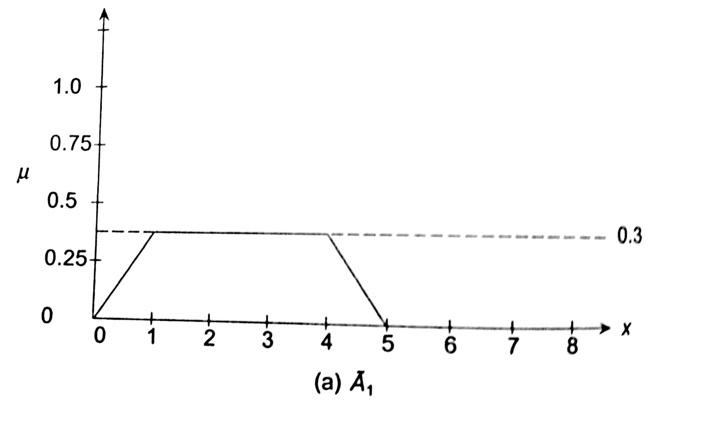
Centroid Method Example : A1, A2 and A3 are three fuzzy sets as shown in below diagram

Slide 18
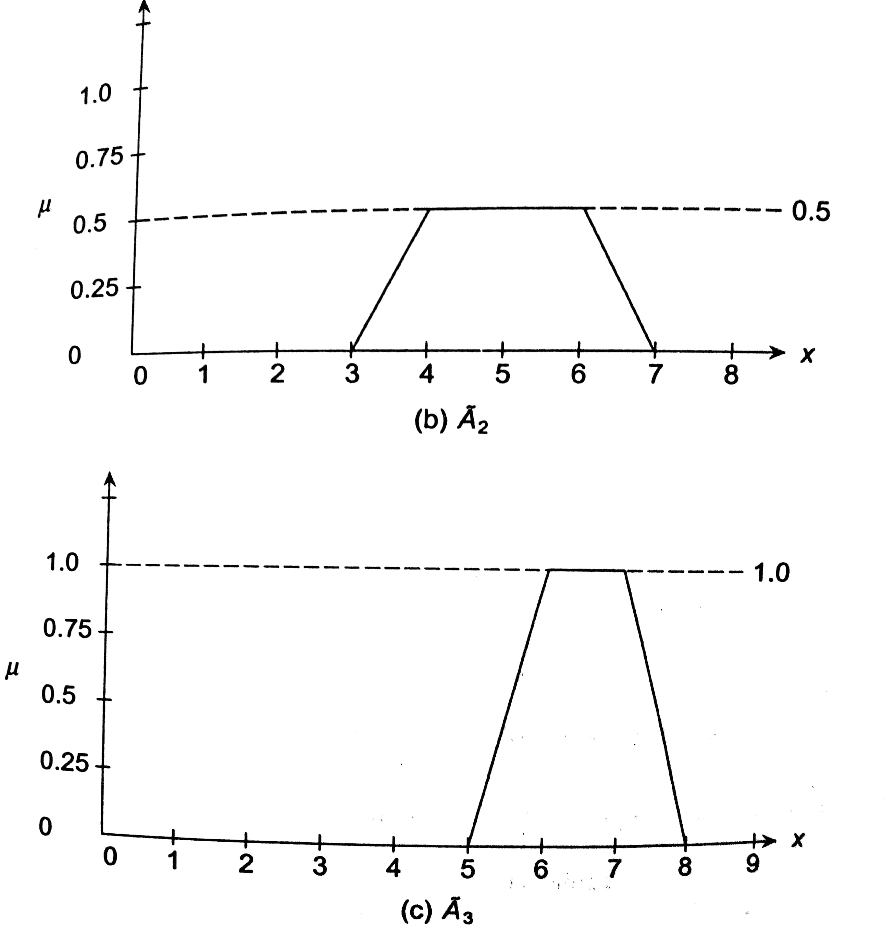

Slide 19
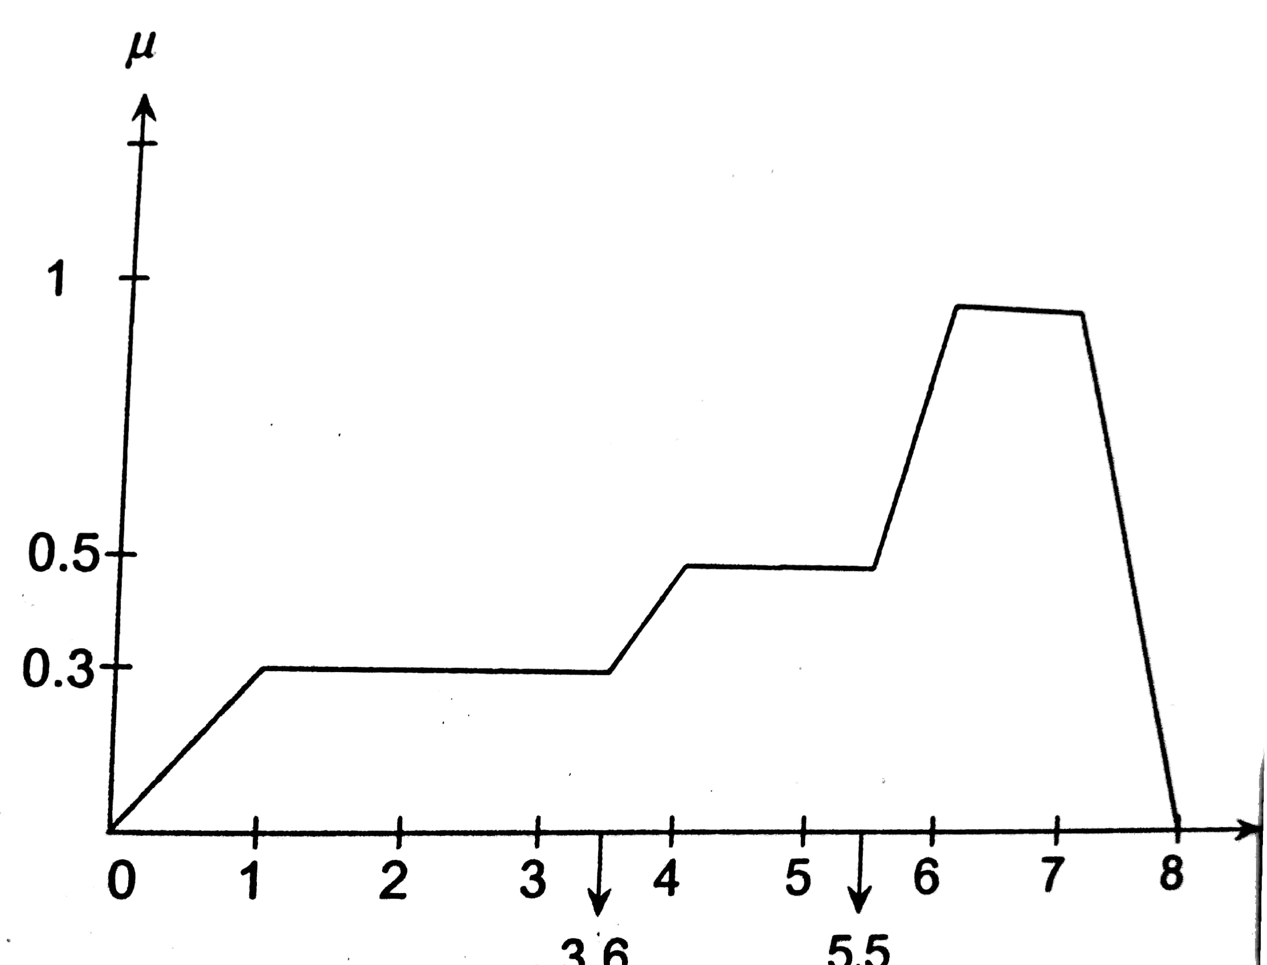

Slide 20
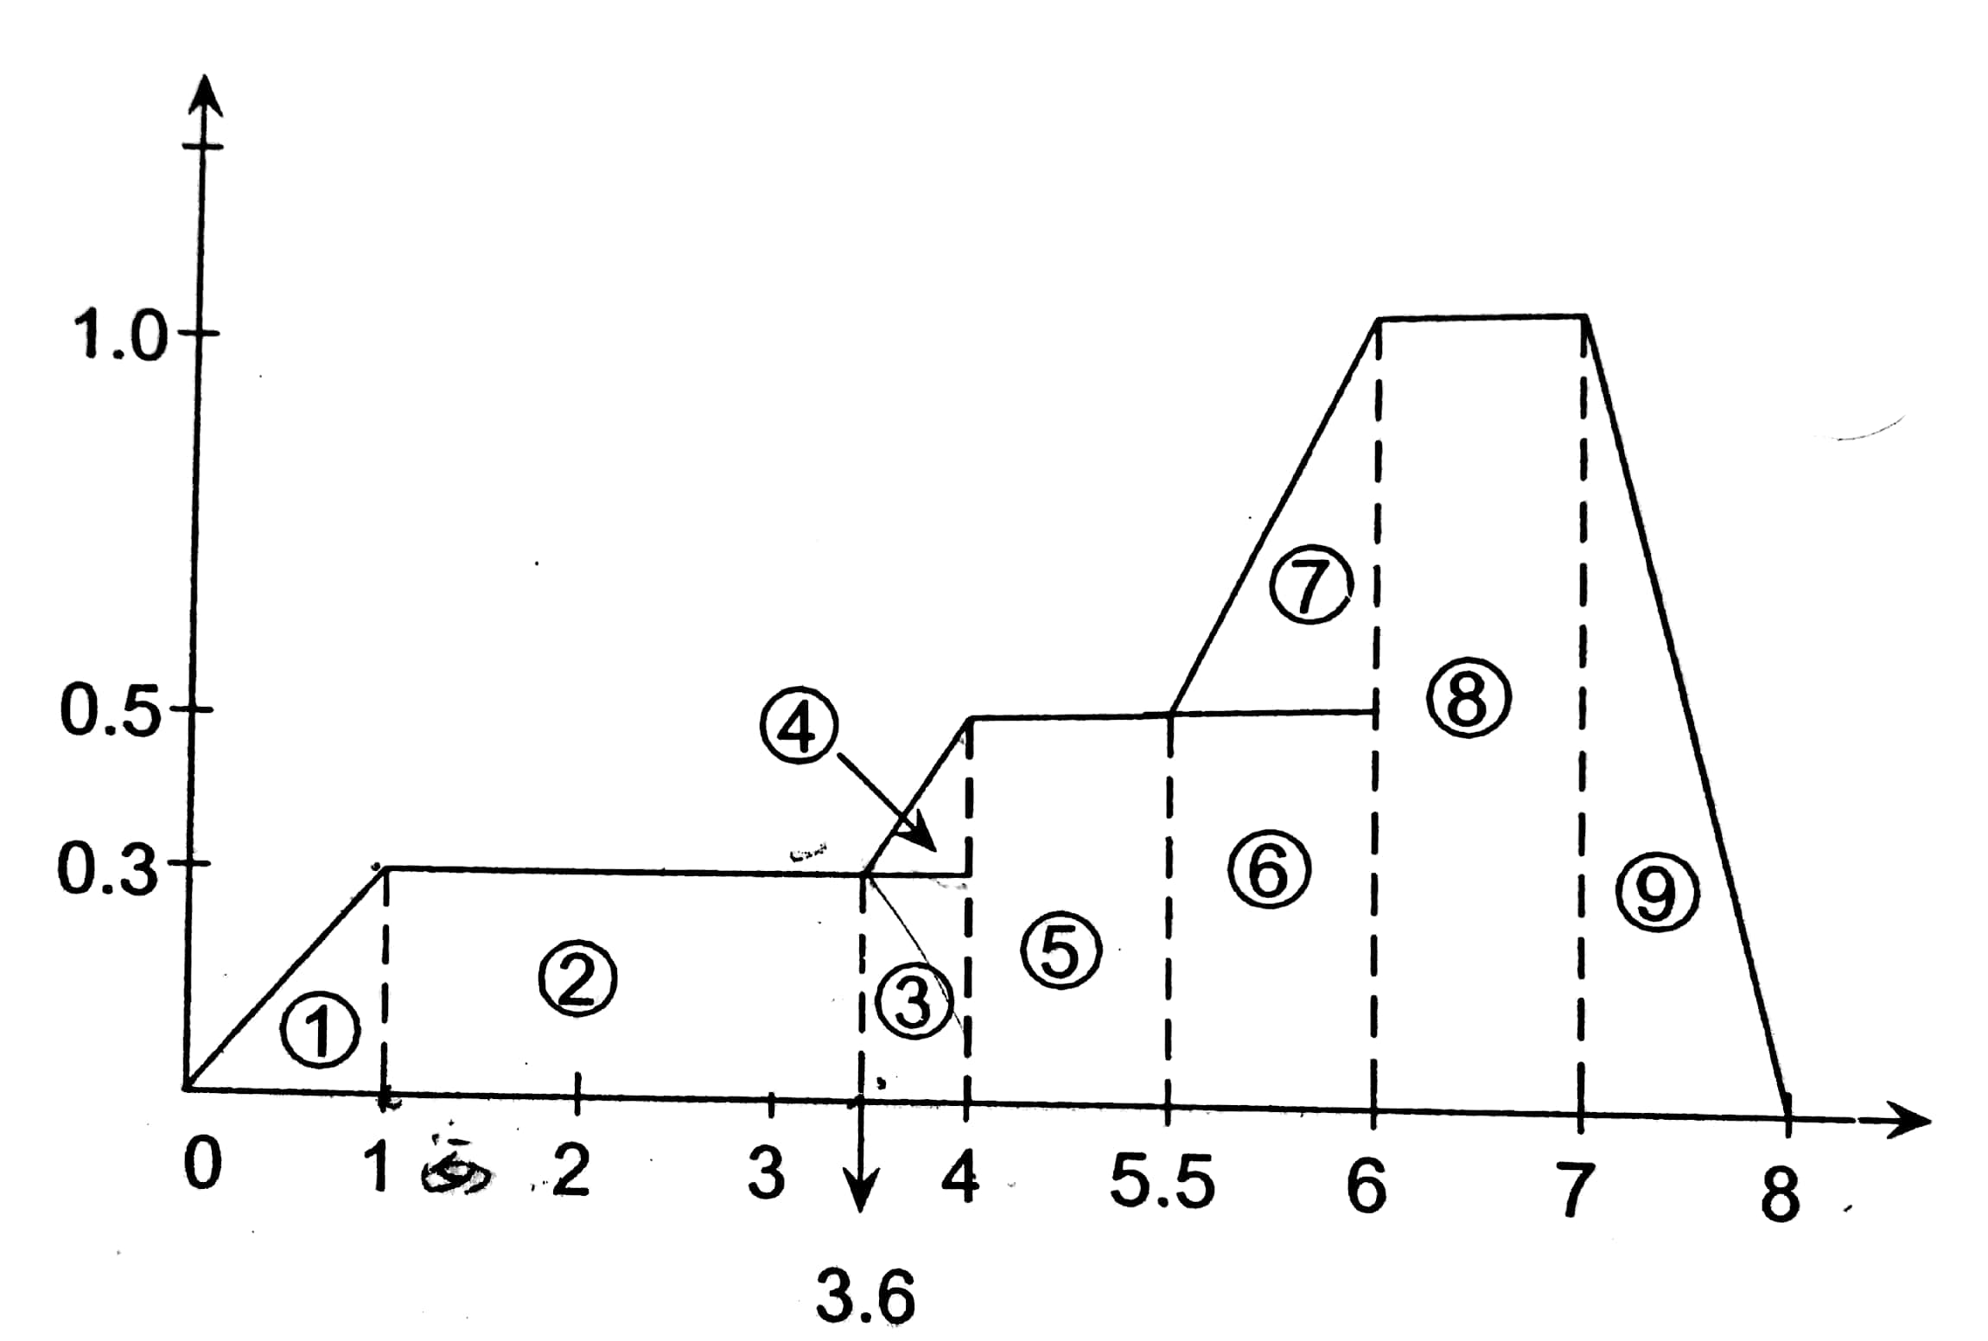

Slide 21
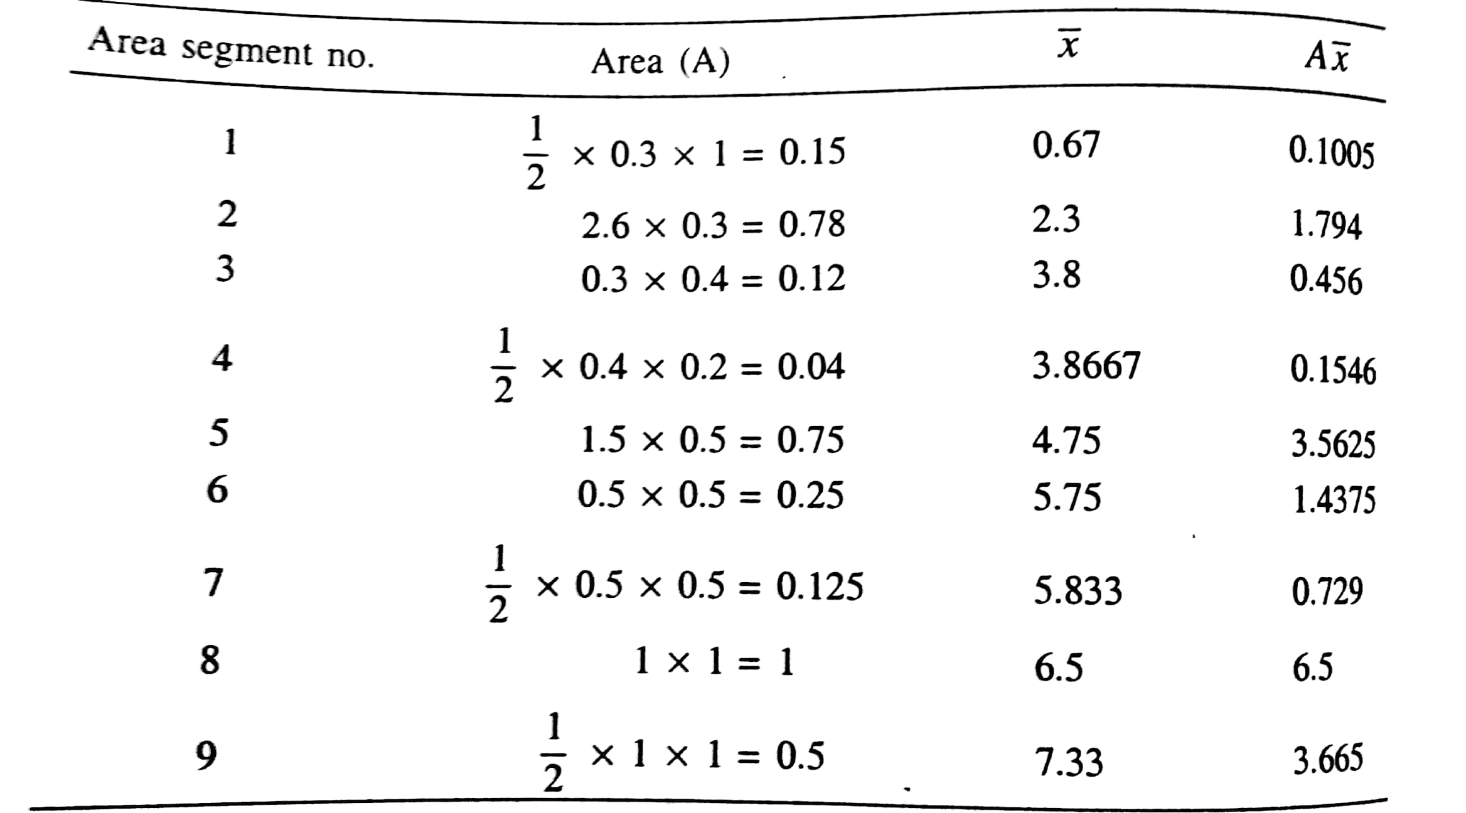

Slide 22
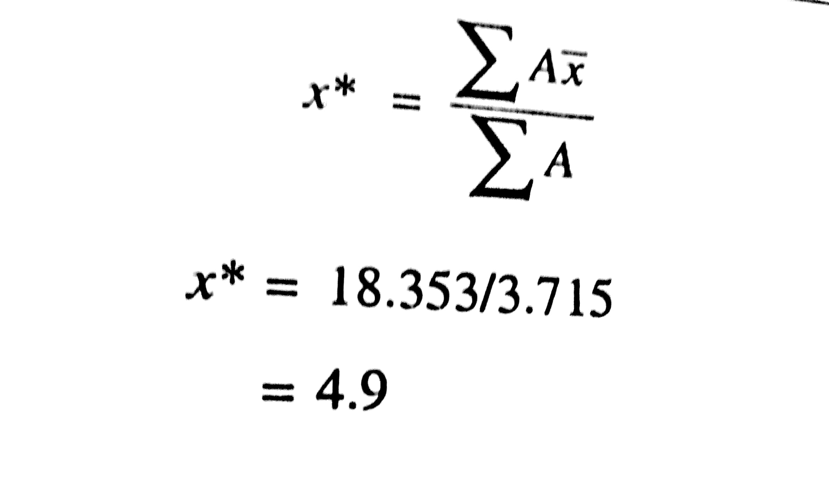

Slide 23
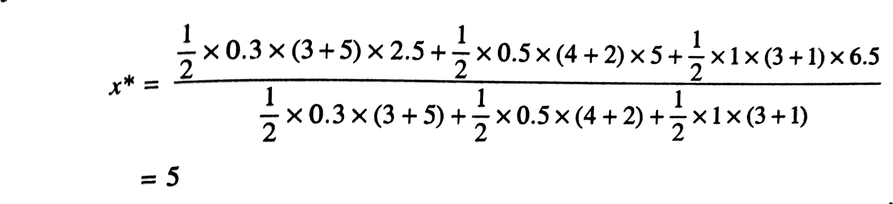
Centre of Sum

Slide 24
First Maxima (or) Last Maxima

Slide 25
Fuzzy Arithmatic

